Slide 1
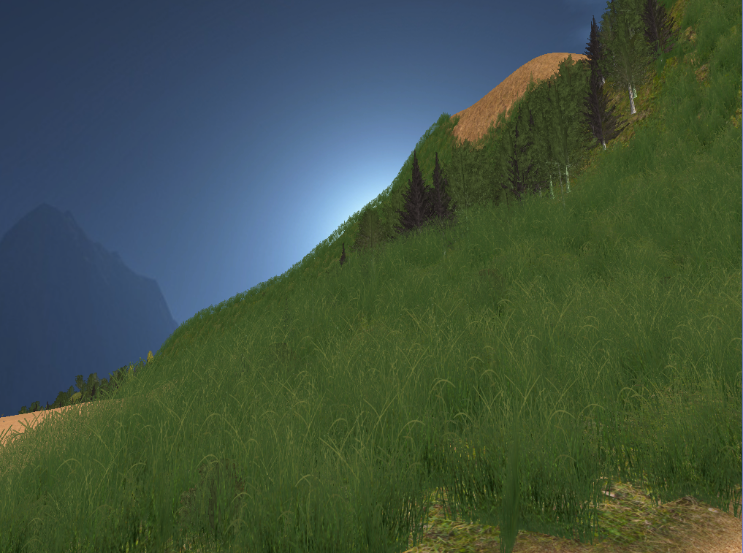
Procedural Terrain
Sebastian Weiss

Slide 2
Why Procedural Terrain?
Large area → exploration
Small details → interest
Endless worlds (e.g. Minecraft)
Time saving for artists
Procedural generation
Artistic control

Slide 3
Overview
Polygonal Map: initial shape
Terrain Features: tune the terrain
Water Erosion: increase realism
Vegetation: add life

Slide 4



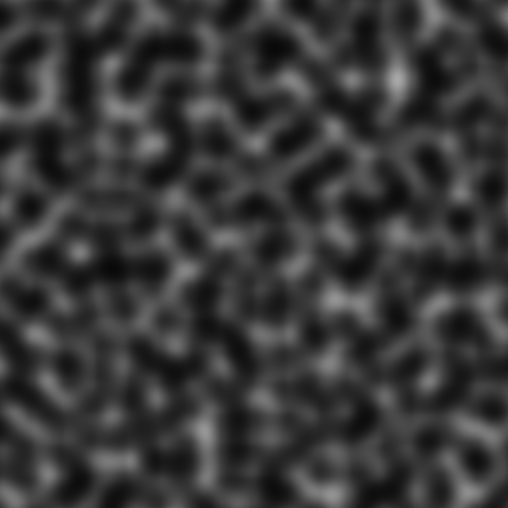
Perlin Noise The programmer’s friend

Slide 5


Slide 6
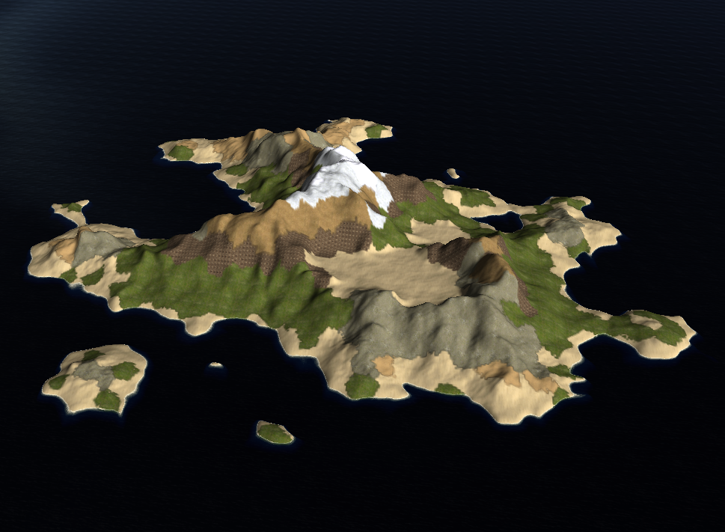
Step 1: Polygonal Map

Slide 7
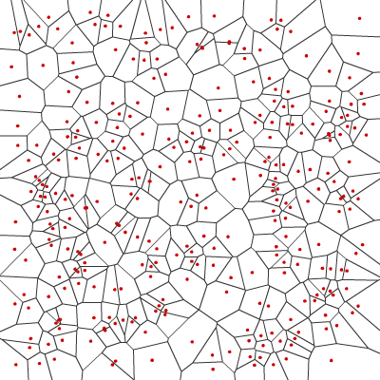
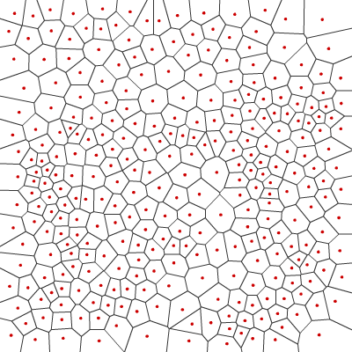
Voronoi diagram

Slide 8
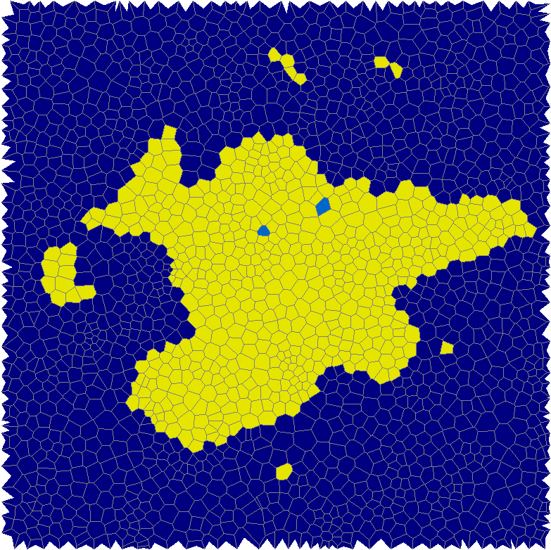
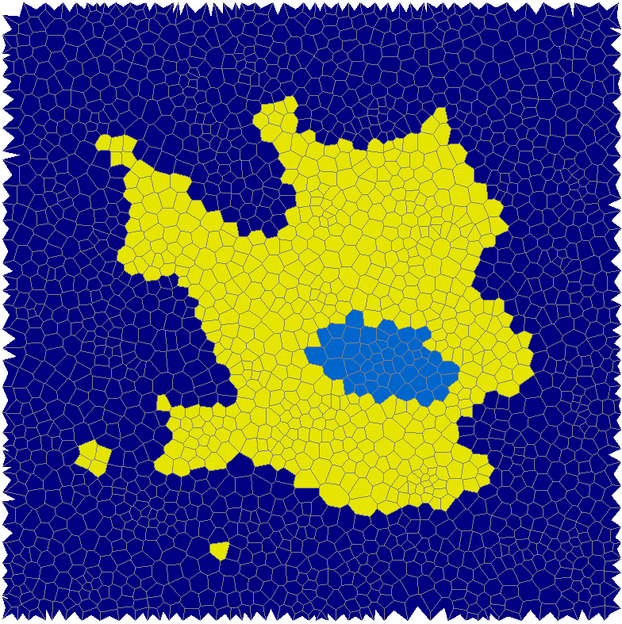
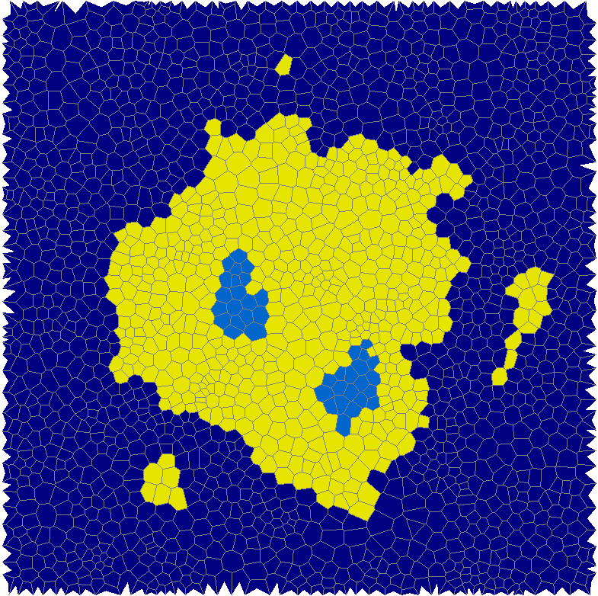
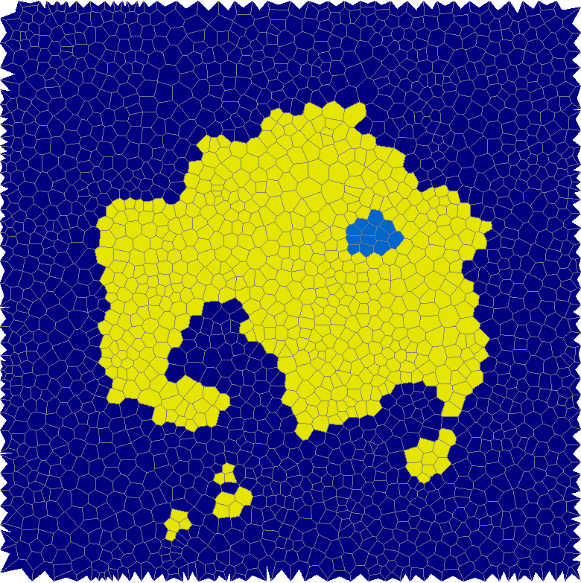
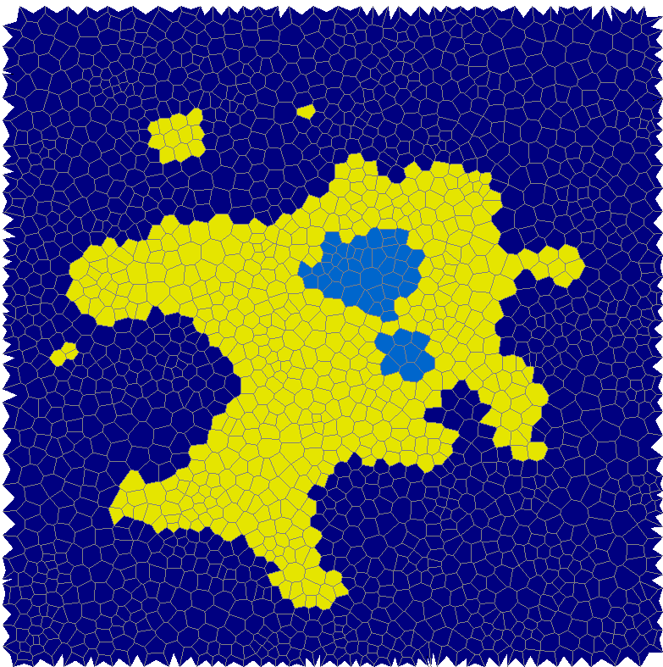
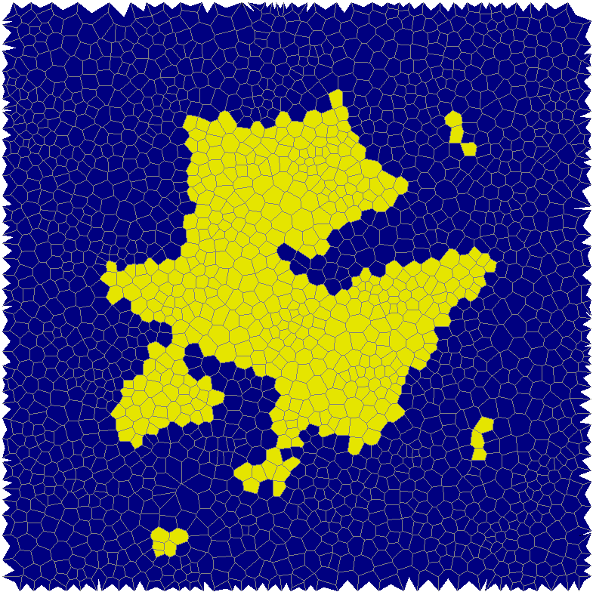
Island shape Perlin noise + distance to the center

Slide 9
Elevation, Temperature, Moisture

Slide 10
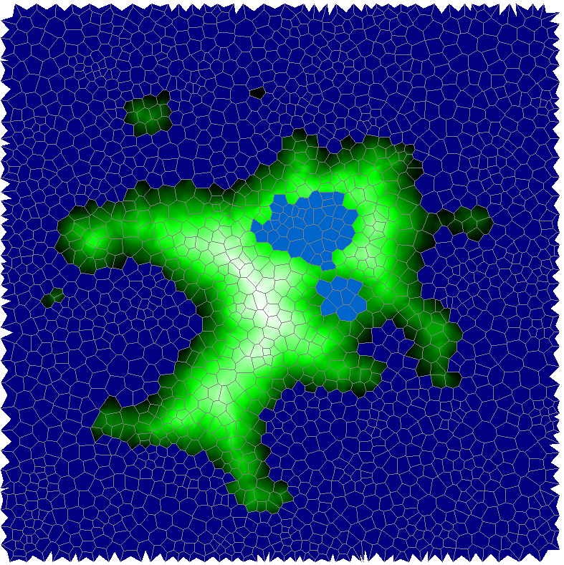
Elevation, Temperature, Moisture

Slide 11
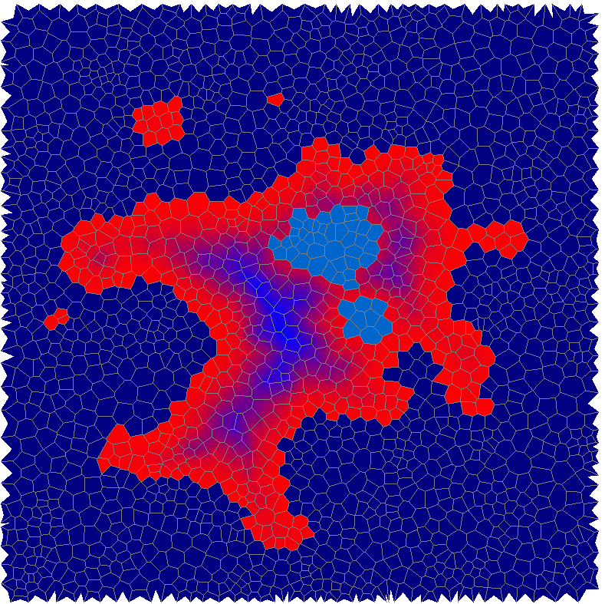
Elevation, Temperature, Moisture

Slide 12
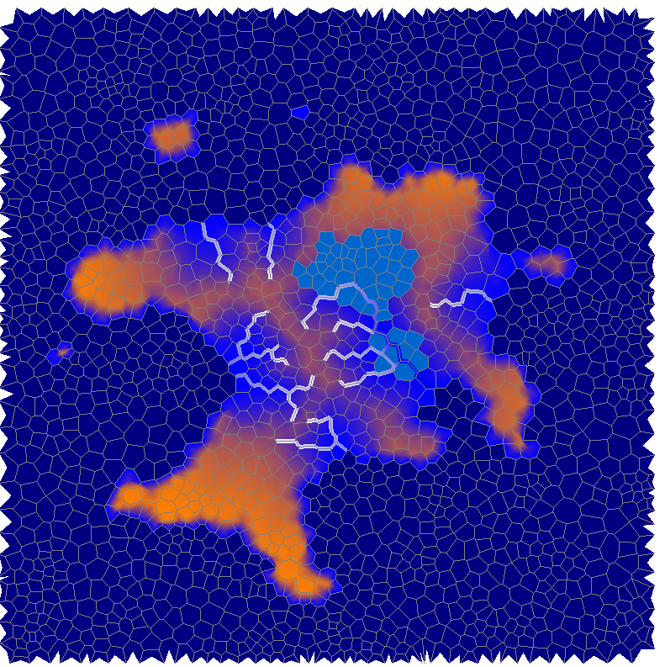
Elevation, Temperature, Moisture

Slide 13
Create height map

Slide 14
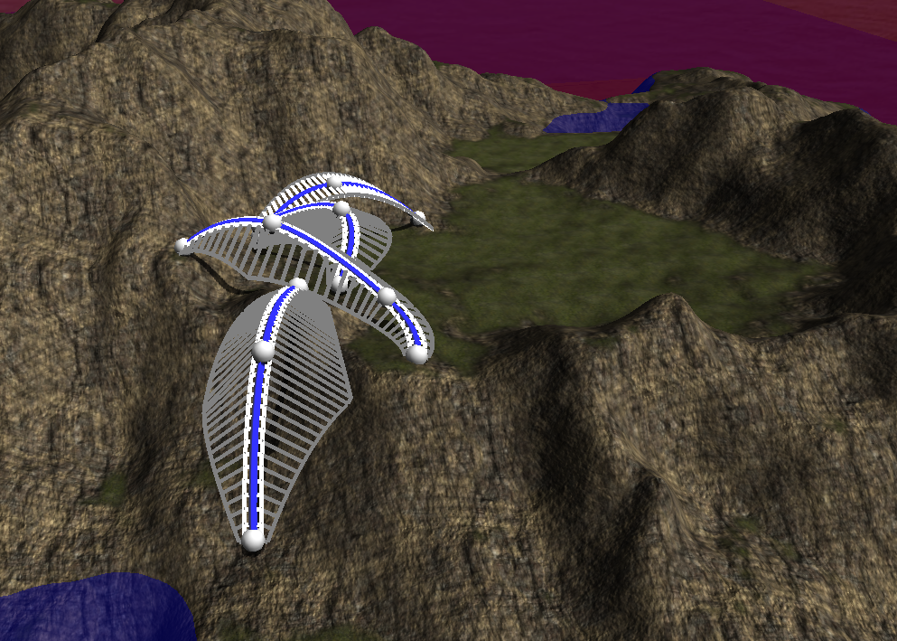
Step 2: Terrain Features

Slide 15
Feature Curves
Interpolation between Control Points
Elevation
Plateau size
Slope size
Slope angle
Smoothing influence

Slide 16
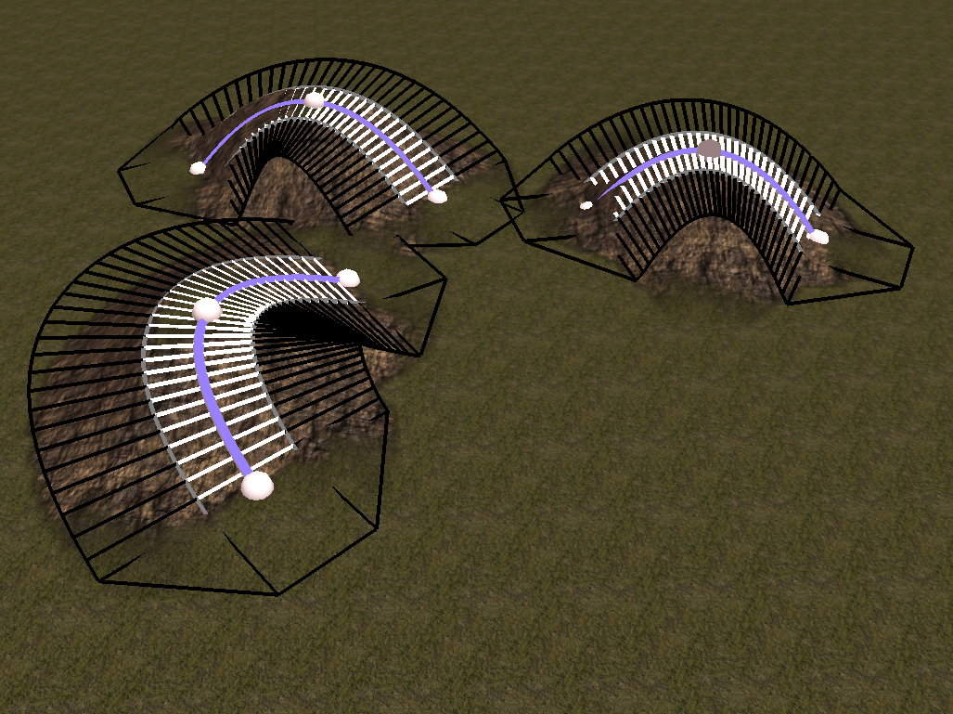
Hills only elevation and smoothing, no slope

Slide 17
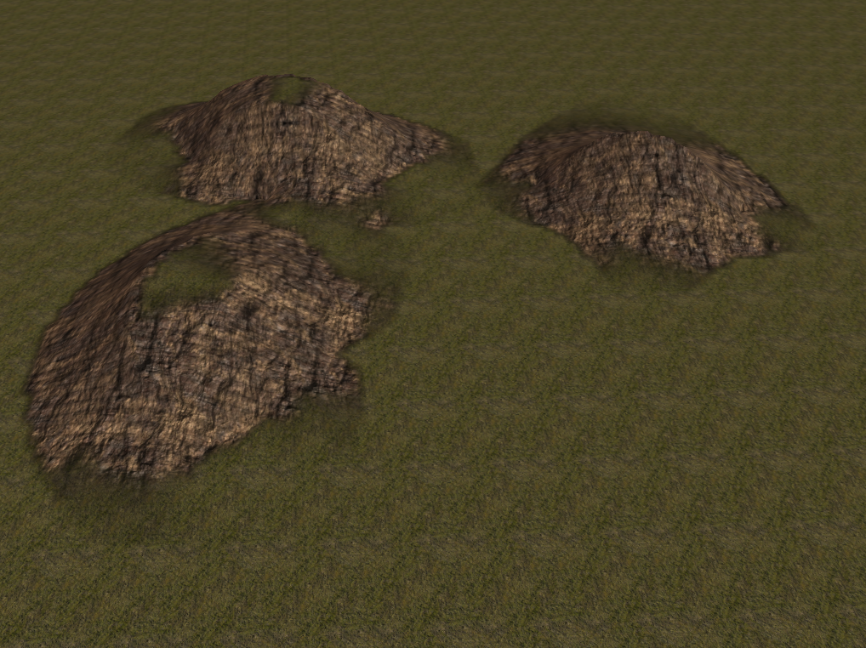
Hills only elevation and smoothing, no slope

Slide 18
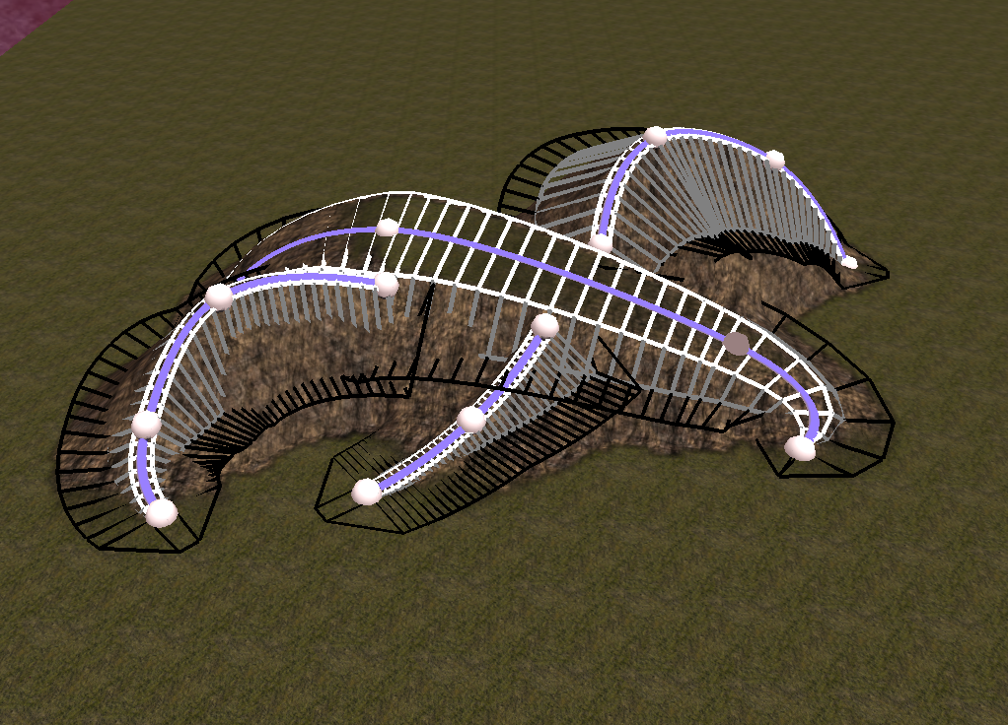
Ridge lines 45° slope

Slide 19
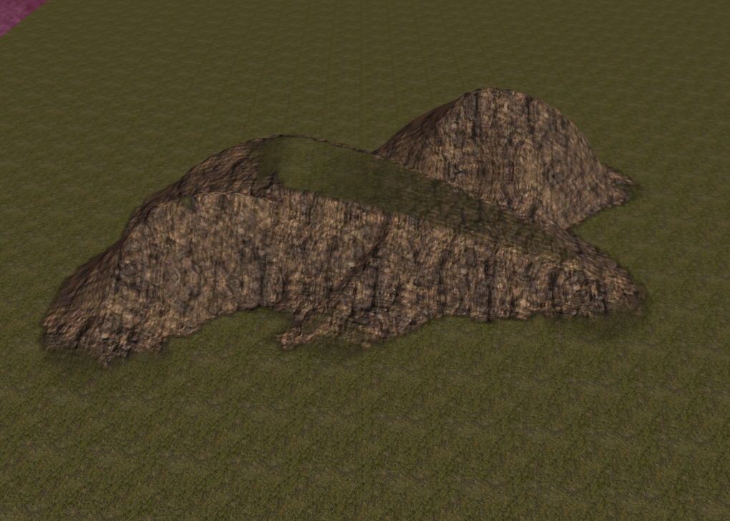
Ridge lines 45° slope

Slide 20
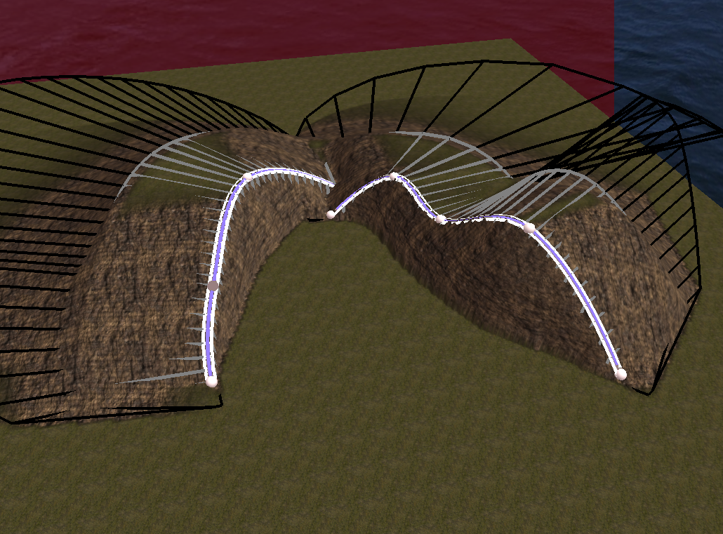
Cliffs 90° slope at one side, long smoothing at the other side

Slide 21
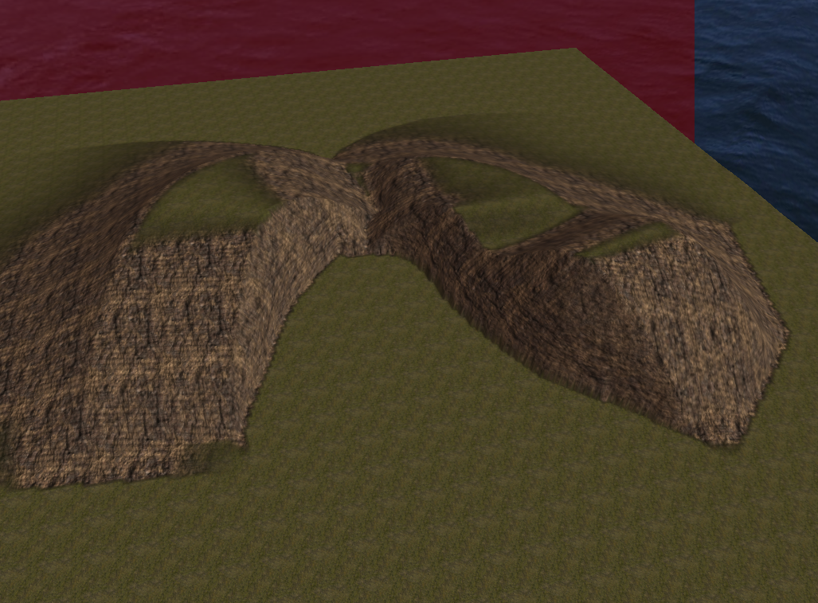
Cliffs 90° slope at one side, long smoothing at the other side

Slide 22
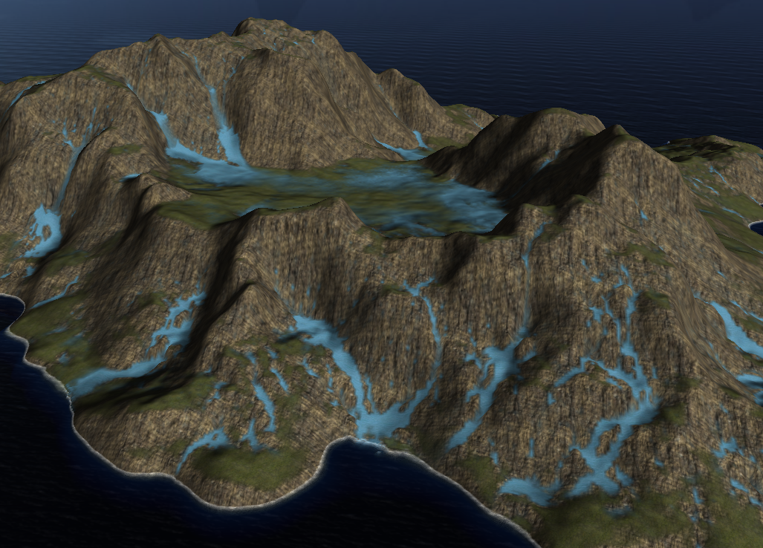
Step 3: Hydraulic Erosion

Slide 23
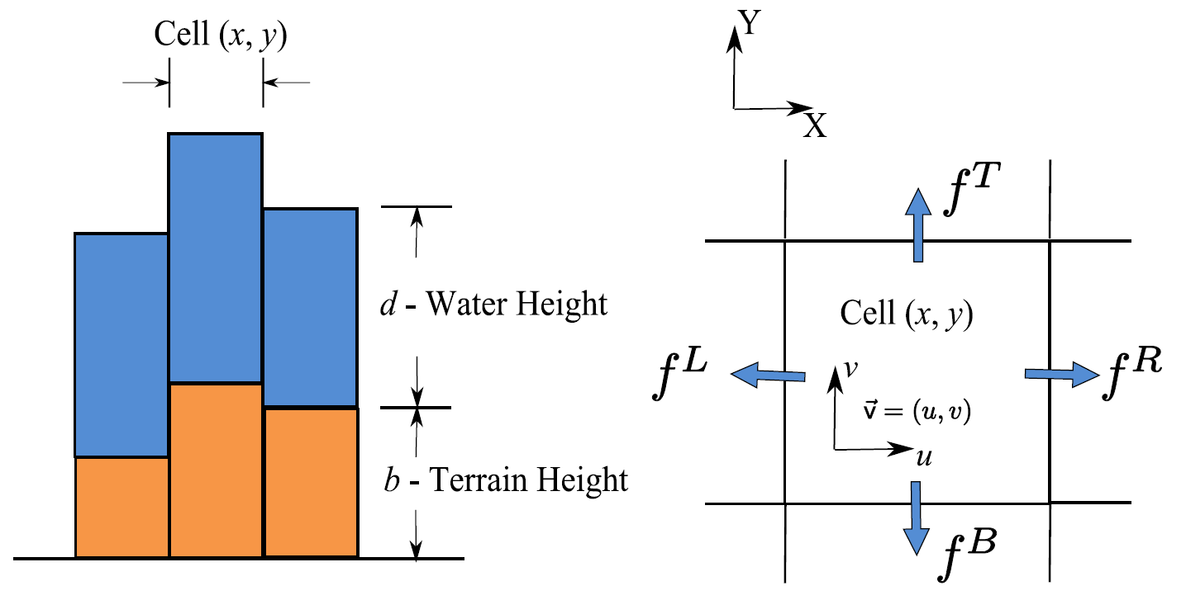
Pipe model
Move water from one cell to another when the height is lower

Slide 24
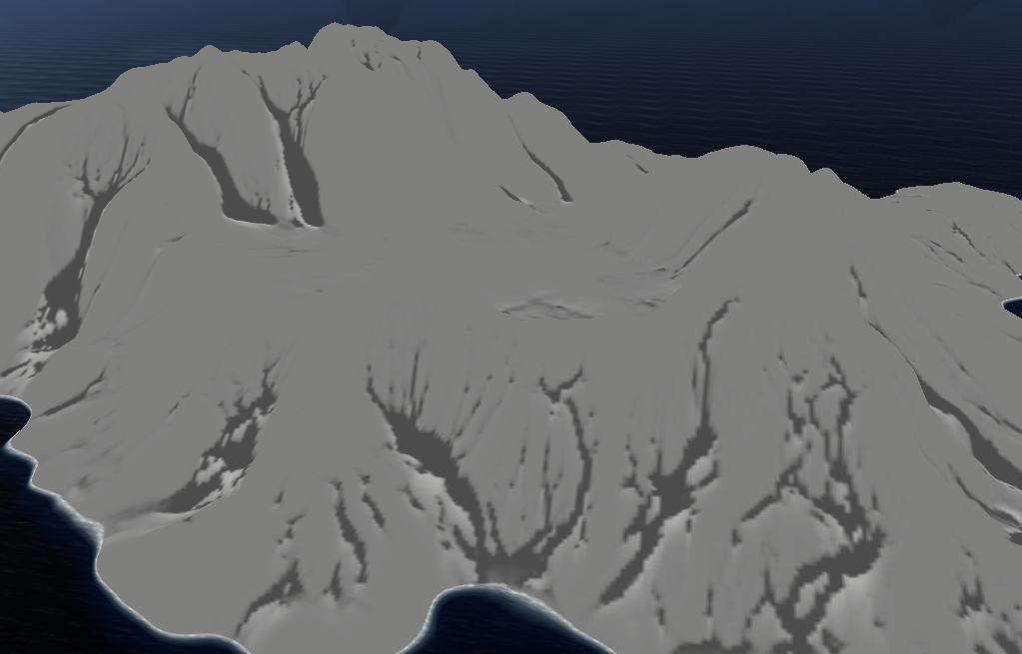
Erosion Water erodes sediment on steep slopes Sediment is deposited on flat areas

Slide 25
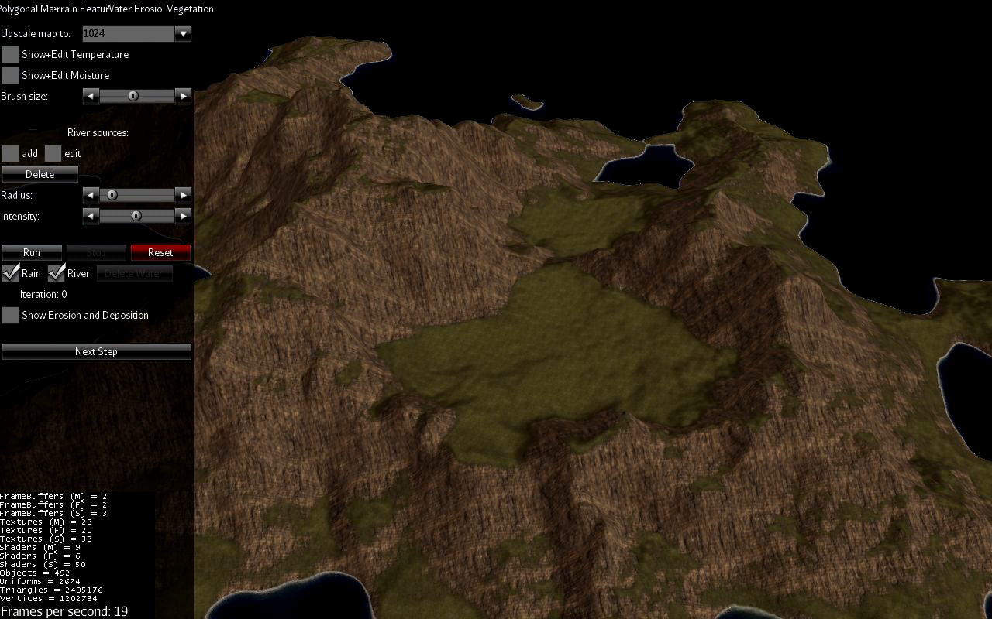

Slide 26
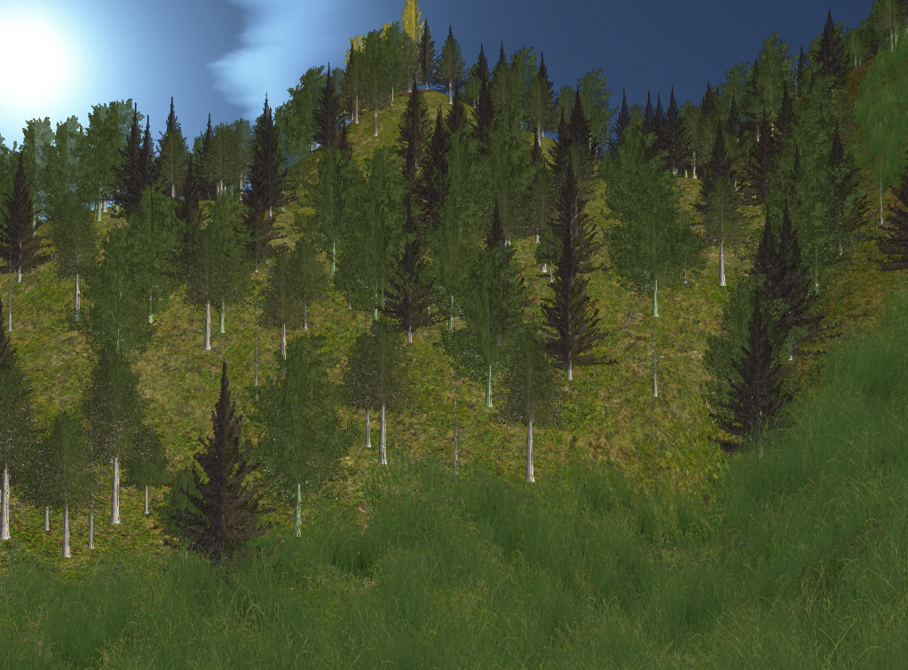
Step 4: Vegetation

Slide 27
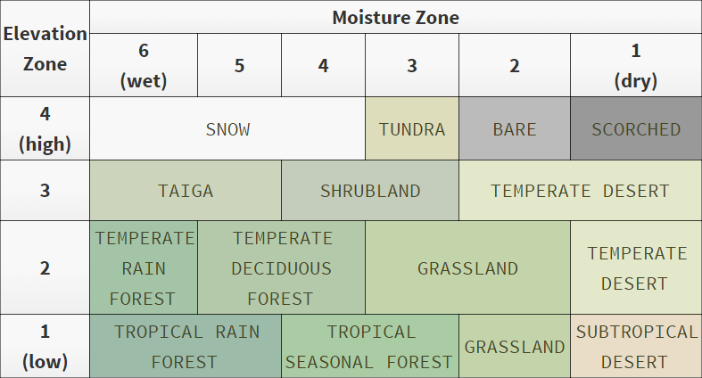
Assign biomes
Texture
Grass density
Tree types

Slide 28
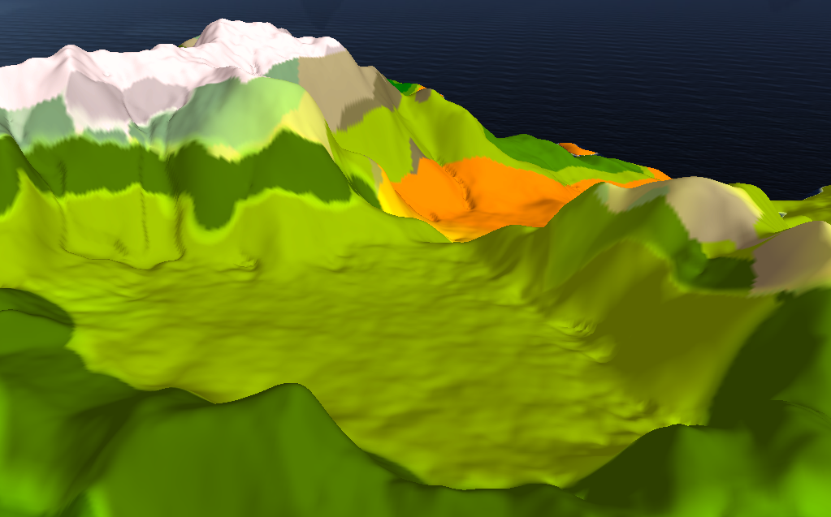

Slide 29
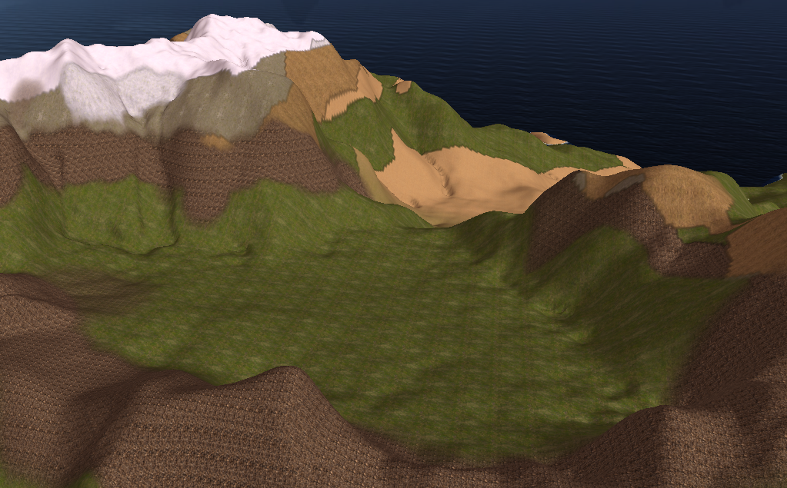

Slide 30
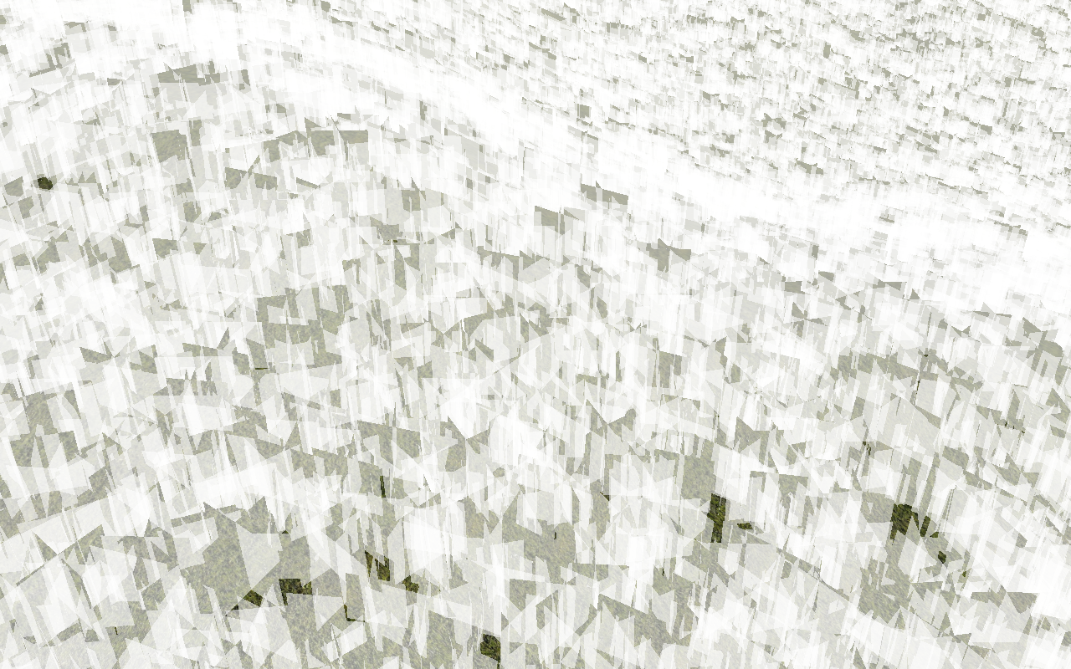
Grass quads with texture

Slide 31
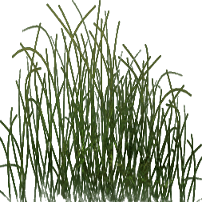
Grass quads with texture

Slide 32
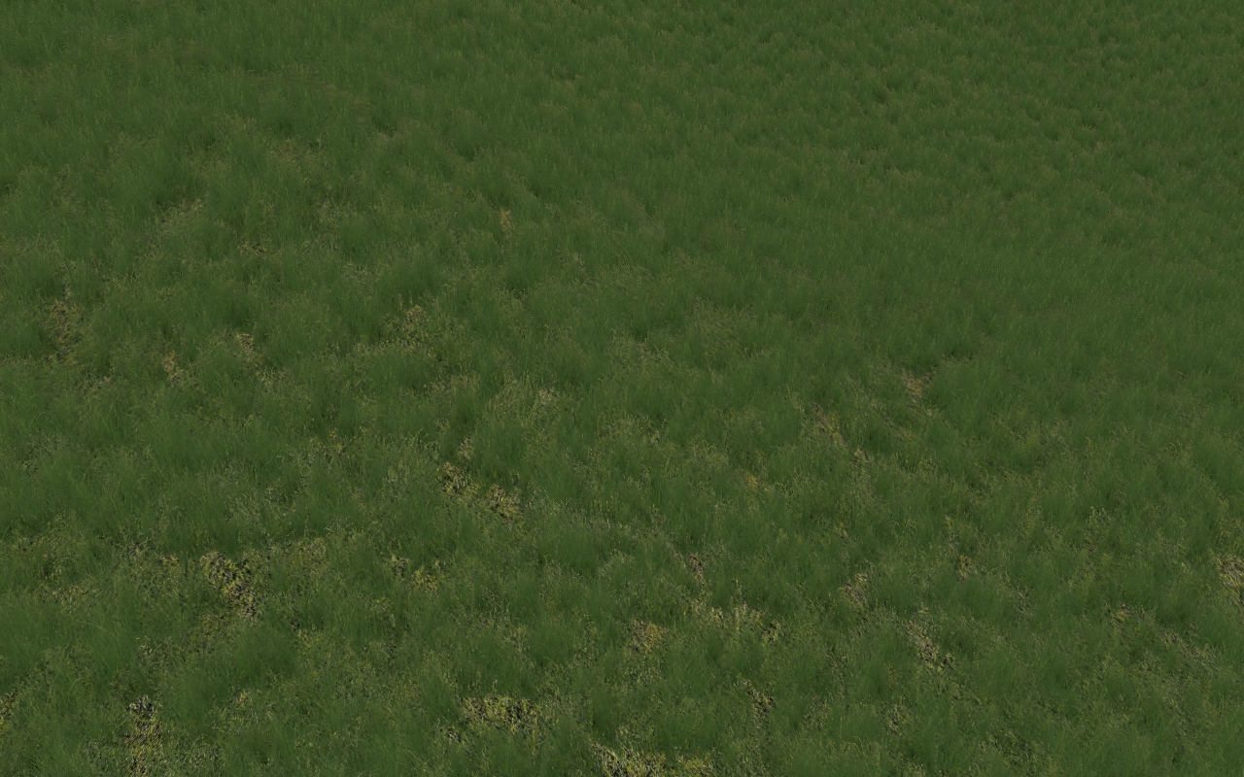
Grass quads with texture

Slide 33
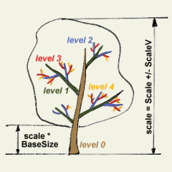
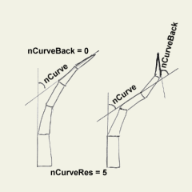
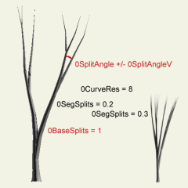
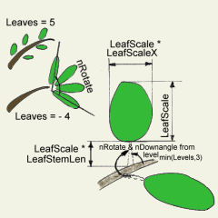
Trees
Define trees recursively
Specify properties for every layer:
Radius, scaling
Curvature
Branching, splitting
Textures

Slide 34
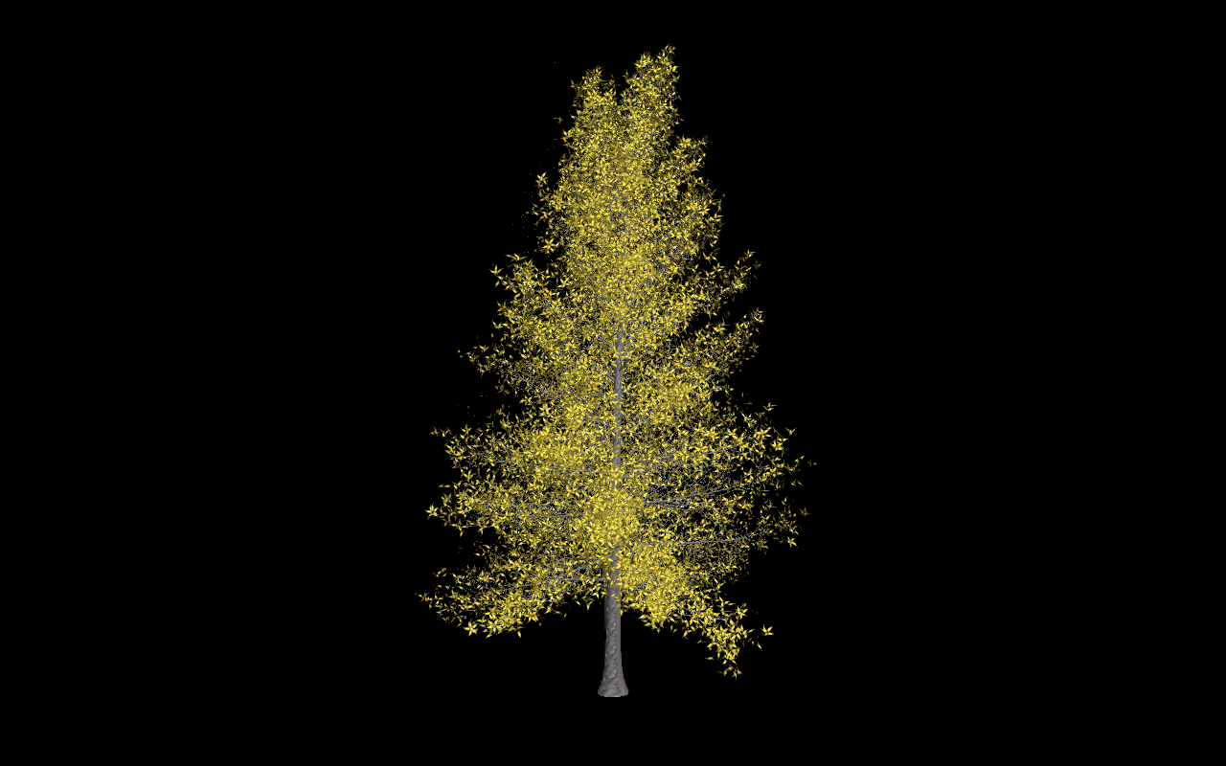
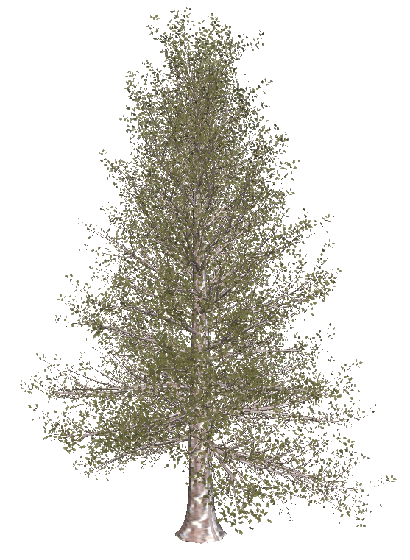
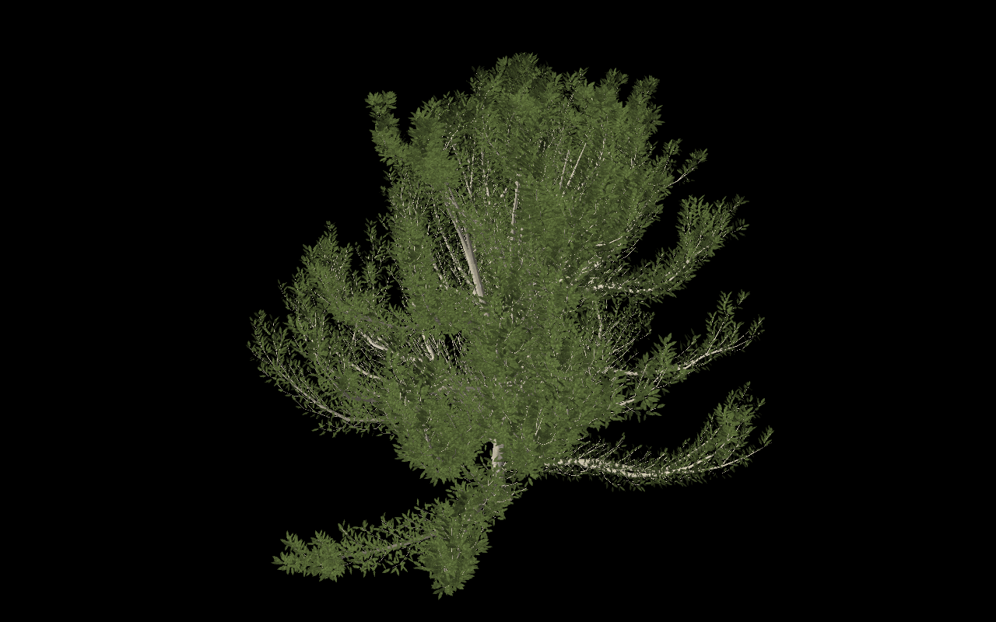

Slide 35
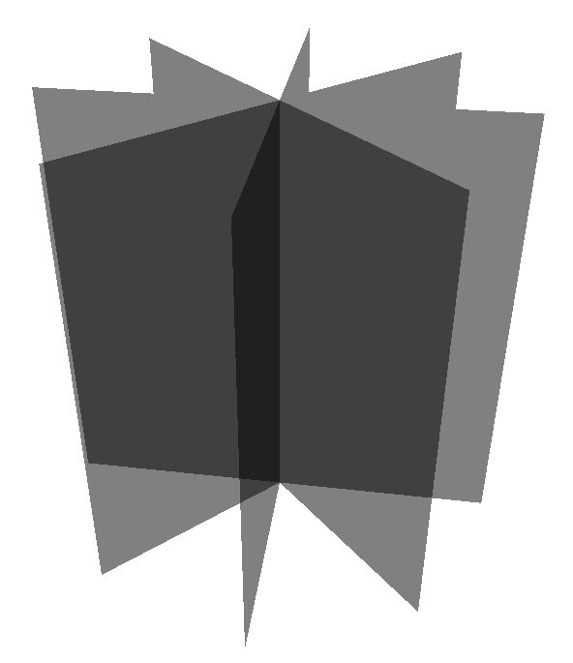
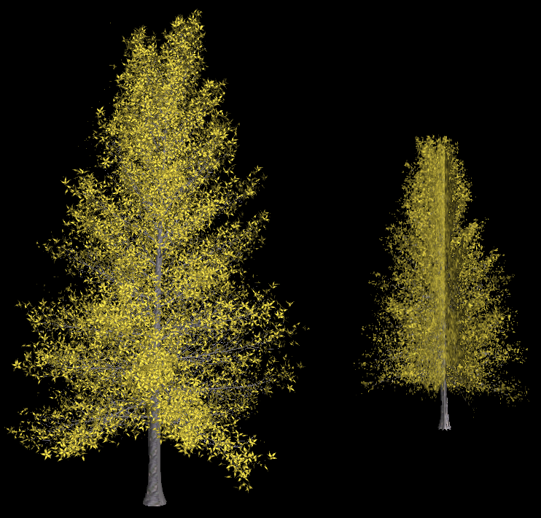
Problem: too many polygons →Use impostors for distant rendering

Slide 36
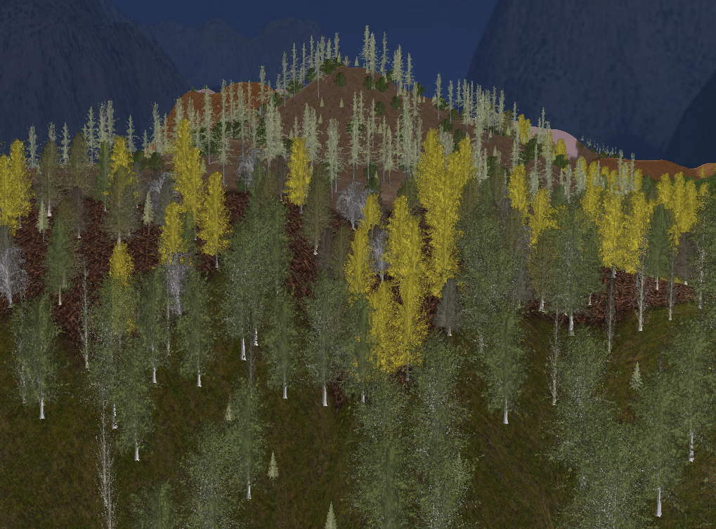
Thanks for your attention

